Slide 1



Recommendation Based
Digital Library System
24-1-D-20
Submitters:
Yuval Zohar
Amit Perets
Supervisor:
Dr Naomi Unkelos Shpigel
-1-

Slide 2
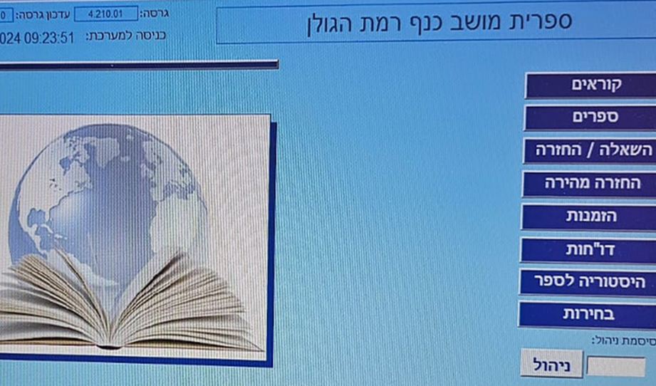
Nowadays
Limited budgets
Outdated technologies
Poor user interface
Lack of personalized recommendations
Moshav Kanaf Library (2011)– Microsoft Access based
-2-

Slide 3
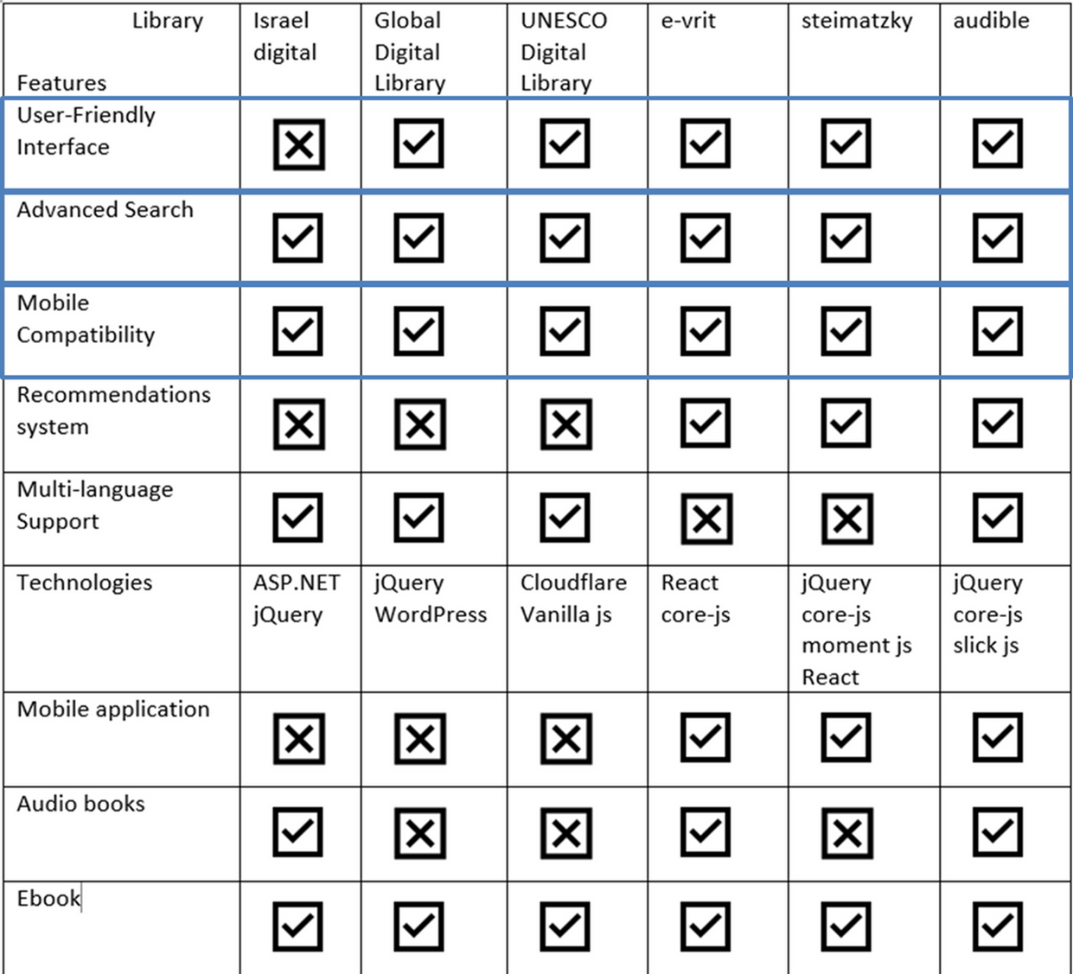

Current Library Websites
Comparison between 6 digital library systems across a variety of features and elements within them
-3-

Slide 4
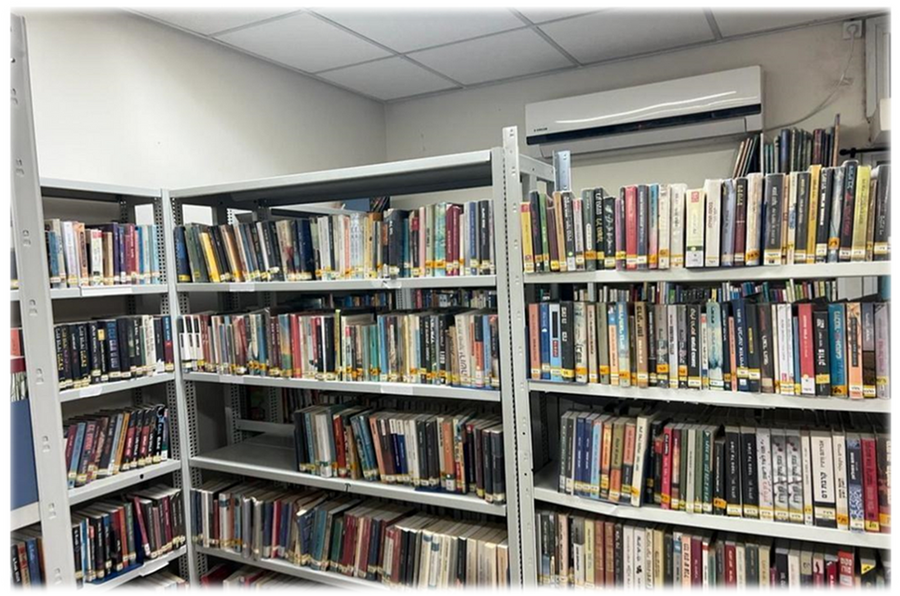
Requirements gathering
Interview with the library staff of Moshav Kanaf:
•Shahar – Library manager
•Dafi - Librarian
Reviewed the current system and its limitations
Gathered requirements for the intended system
Received guidelines to support the development process
-4-

Slide 5

Requirements gathering
Survey for readers communities & potential readers
Survey for readers communities & potential readers
What additional features would you like to see in our system?
Do you prefer using our system on a phone or a PC?
Would you be interested in borrowing digital books through our system?
Are there any websites with features you particularly like? If so, which features and why?
Do you have any suggestions for enhancing the user experience on our platform?
-5-

Slide 6
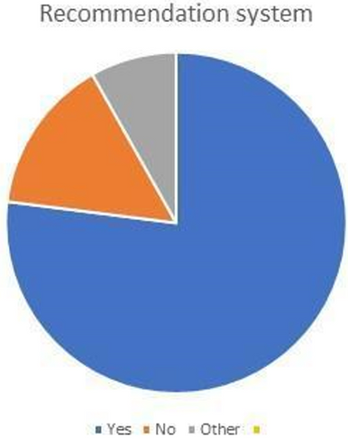
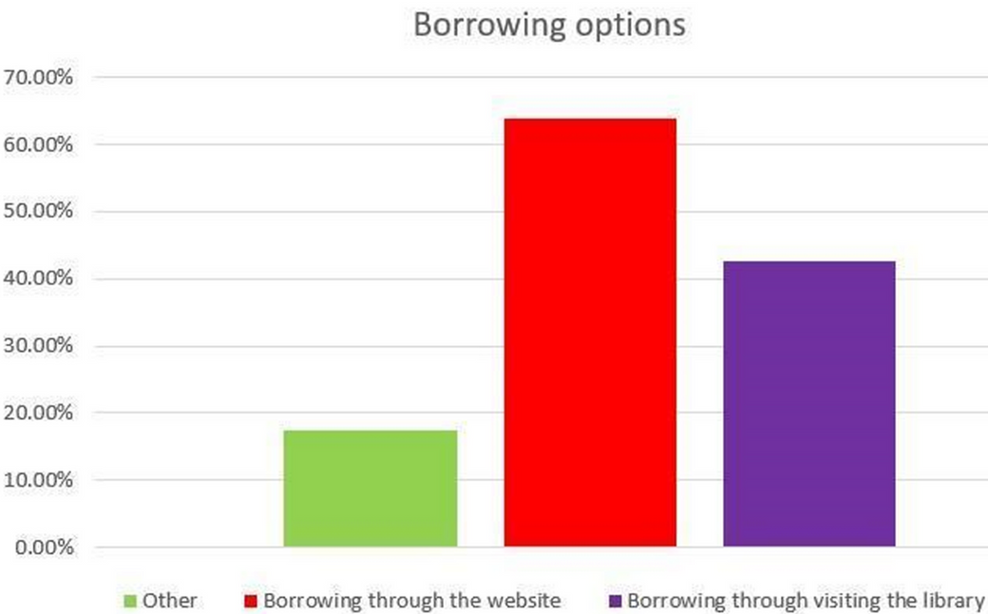
Questionnaire results
5
61 responses
Recommendations
Waiting lists
Borrowing through website
Notifications
Late book return
9
47
38
26
11
-6-

Slide 7
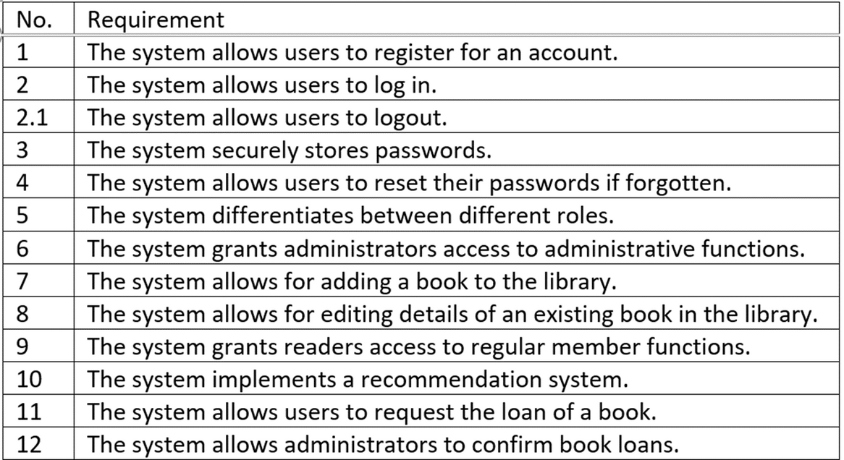
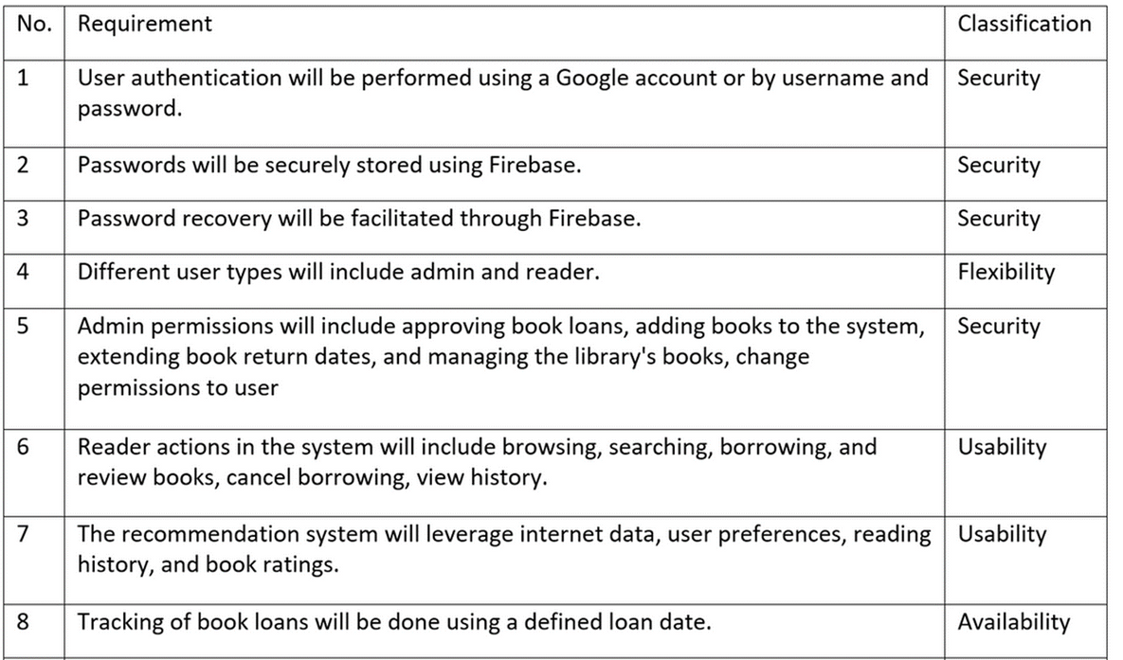
Requirements drawn from the interviews
Functional requirements
Non-Functional requirements
-7-

Slide 8

Our Solution
Modern Technologies
Implemenation of a user-friendly interface
Adaptions for those lacking technological knowledge
Integration of recommendation system
Free accessiblity to both small and large libraries
-8-

Slide 9
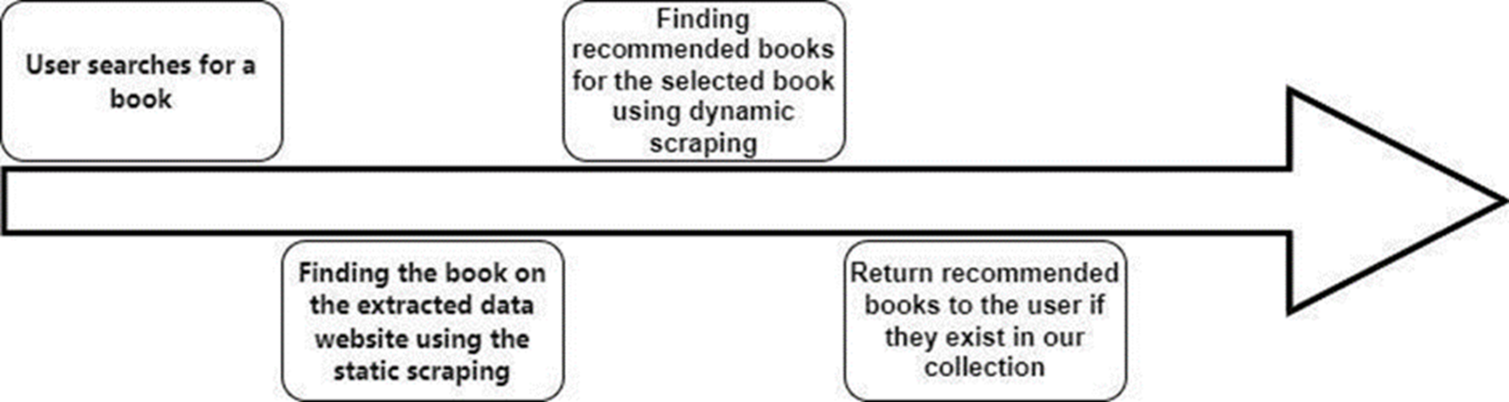
Algorithm - Web scraping
Why not to use AI directly ?
Data !!
-9-

Slide 10
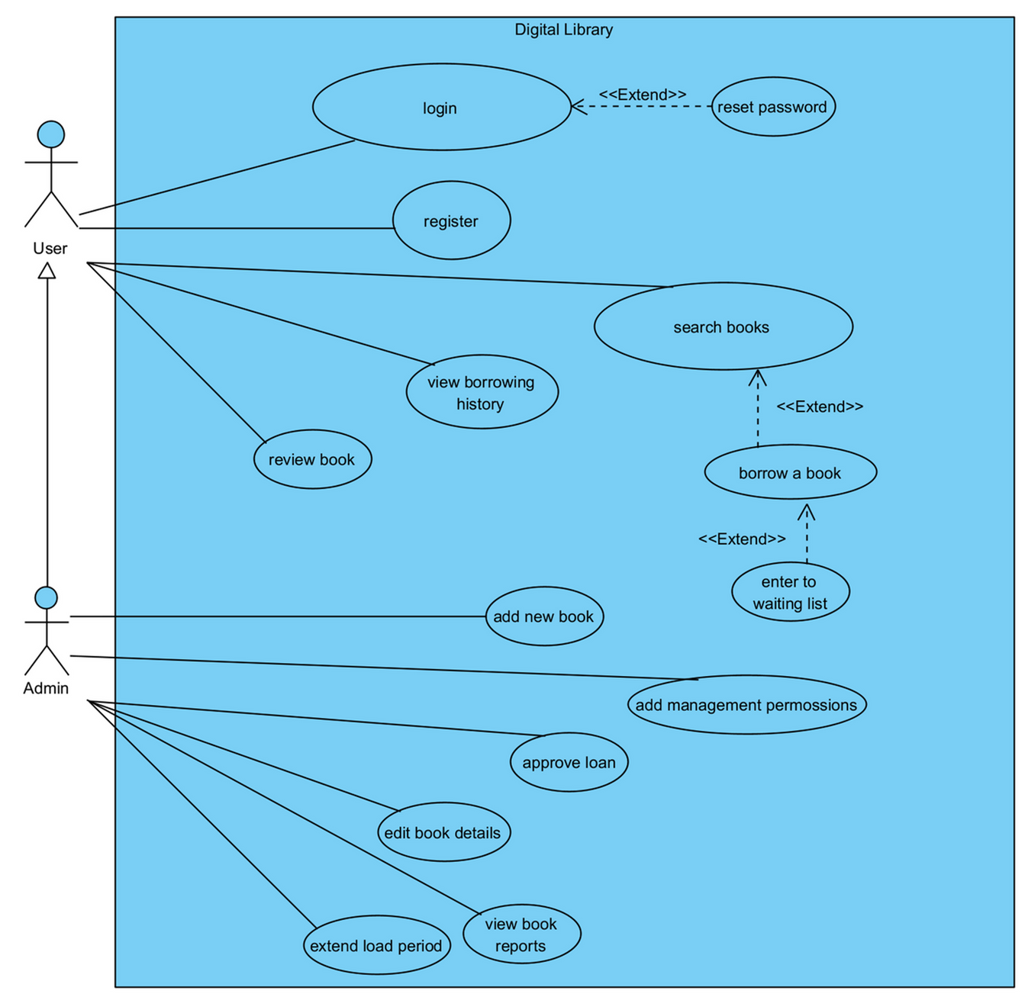

Use case diagram
-10-

Slide 11
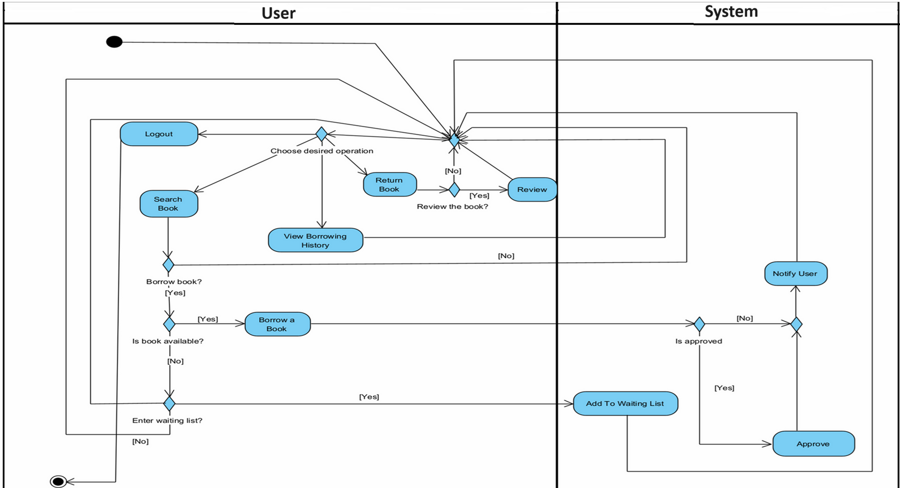
Activity diagram
-11-

Slide 12
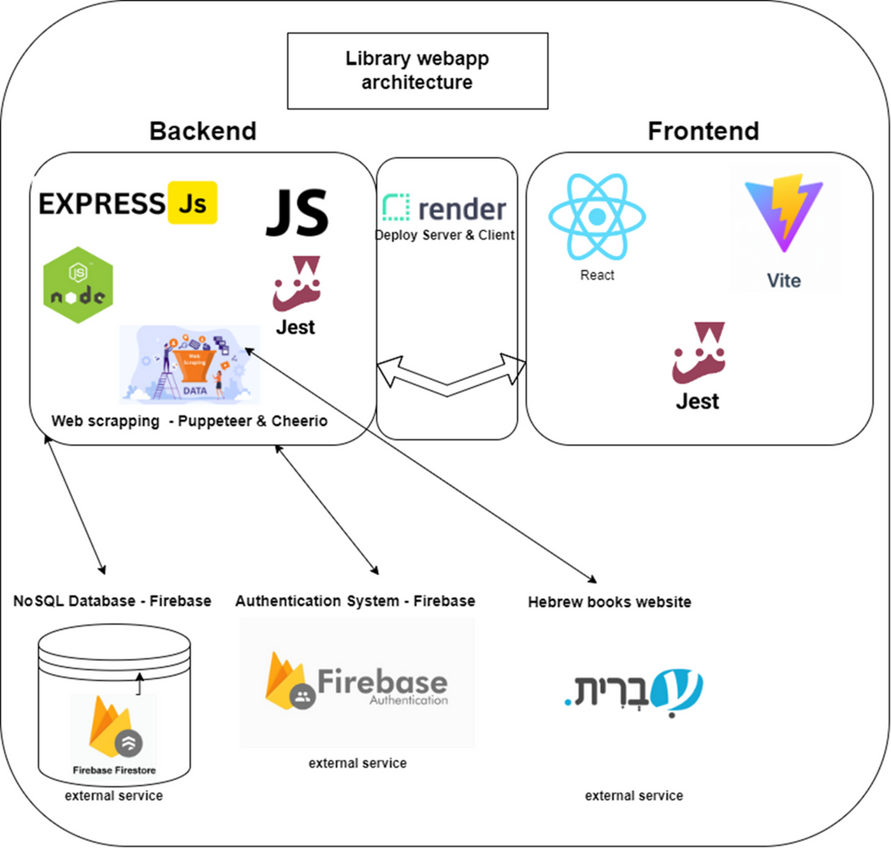
System architecture
-12-

Slide 13
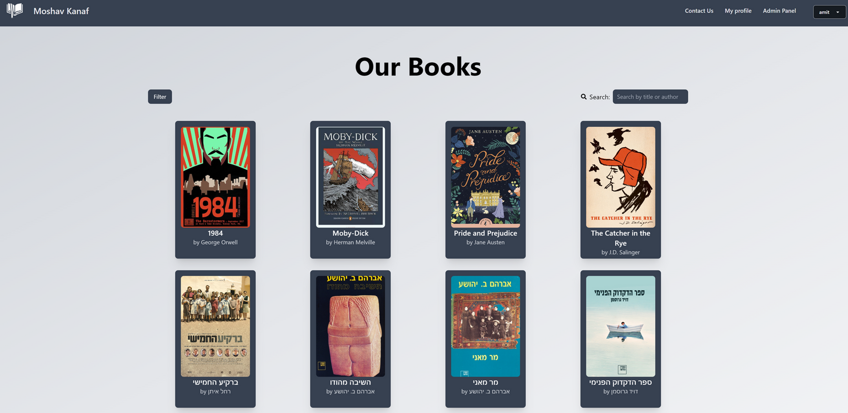
Prototype
Search books page
-13-

Slide 14
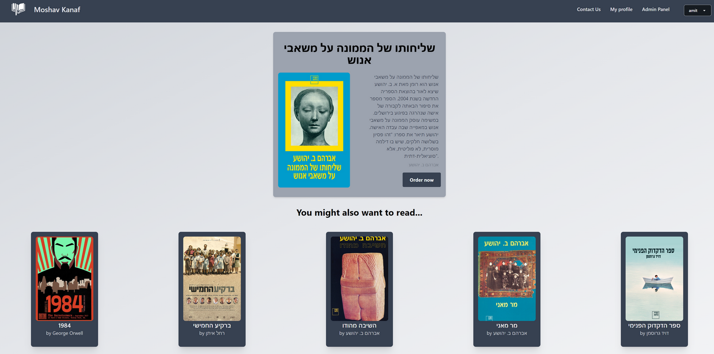
Prototype
Order a book page
-14-

Slide 15
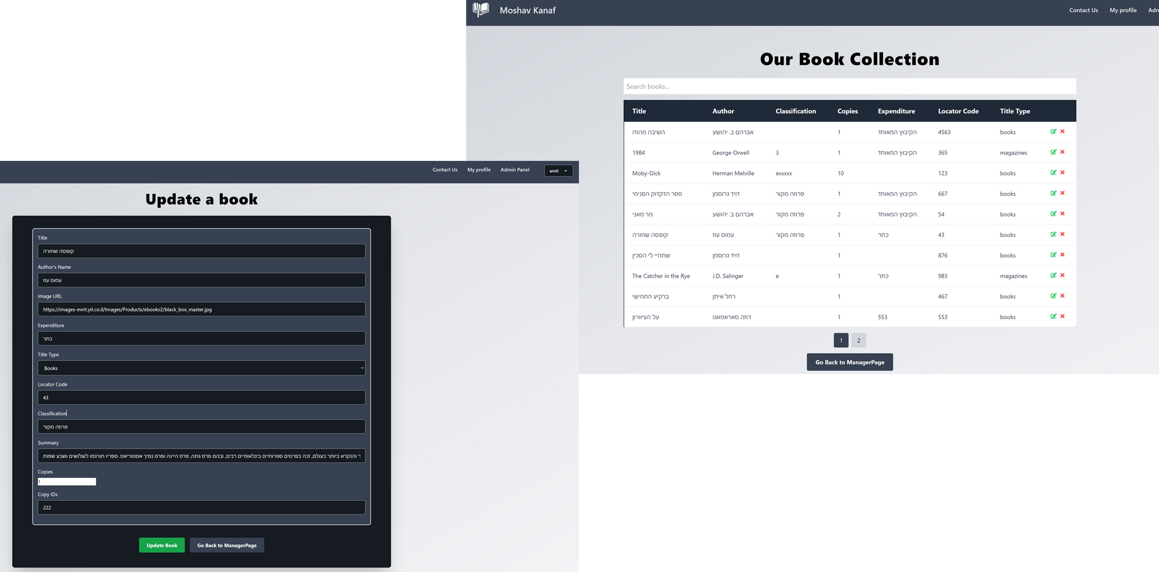
Prototype
Admin panel page
-15-

Slide 16
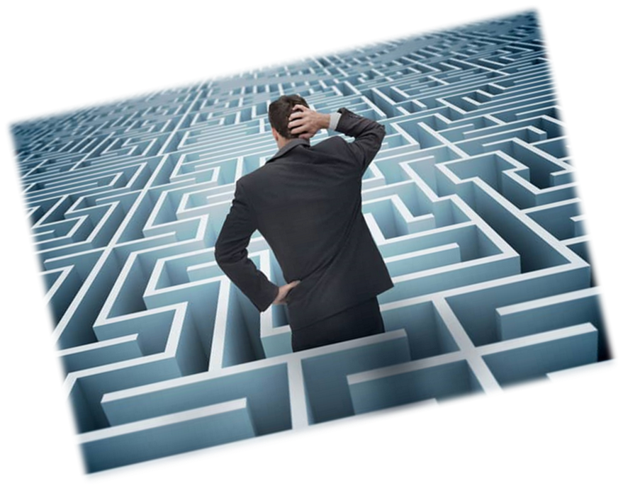
Challenges
Tracking books copies
Lack of large Hebrew book API or dataset
Web-scraping
Gather information from outdated and disorganized files containing data about the library
-16-

Slide 17

Metrics
30% increase in digital library usage, 85% user satisfaction
99.5% availability, <2s response time
70% user adoption within 3 months
100% staff adoption within 1 months
-17-

Slide 18
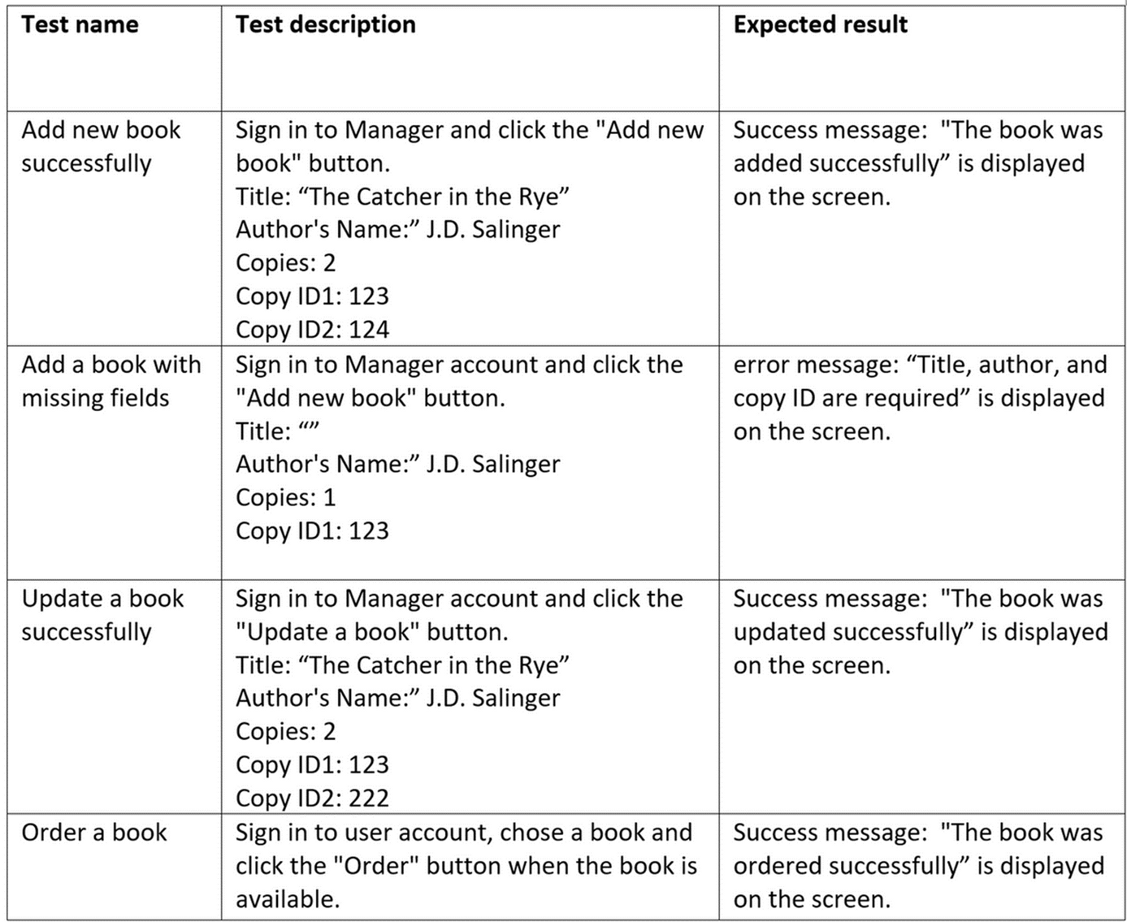
Tests
Login tests
Ordering books tests
Editing books tests
-18-

Slide 19

Thank you
-19-

